Slide 1
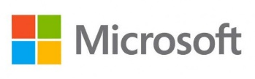
BizSpark, Azure & Microsoft tools. Directions to use your BizSpark enrollment code at a hackathon.
It gives you free access to $140K worth of Microsoft products.
Notes:
Not sure if we are able to give the dollar value for this. We should check.

Slide 2
Developers, you probably want to use Azure. These are directions to do just that. (…and takes about 15 minutes.)
Everyone else, you can definitely benefit from a BizSpark code – including free access to Microsoft Office and other products. Follow these instructions through signing up for the Microsoft BizSpark account, and then poke around the site to find the software that you want to use.

Slide 3

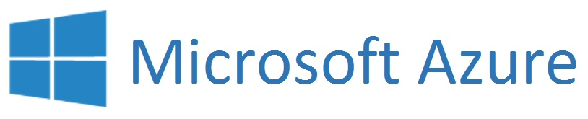
To get to Azure, you need to create 3 separate accounts.
Notes:
I liked the feeling of the last slide. Maybe we can poke fun at ourselves here and say something like "Yeah, we know. But it's worth it."

Slide 4
You will want to have some information handy.
Your BizSpark enrollment code, email address, phone number, and other basic info.

Slide 5


Follow the bottom icons to see where you are in the process.

Slide 6
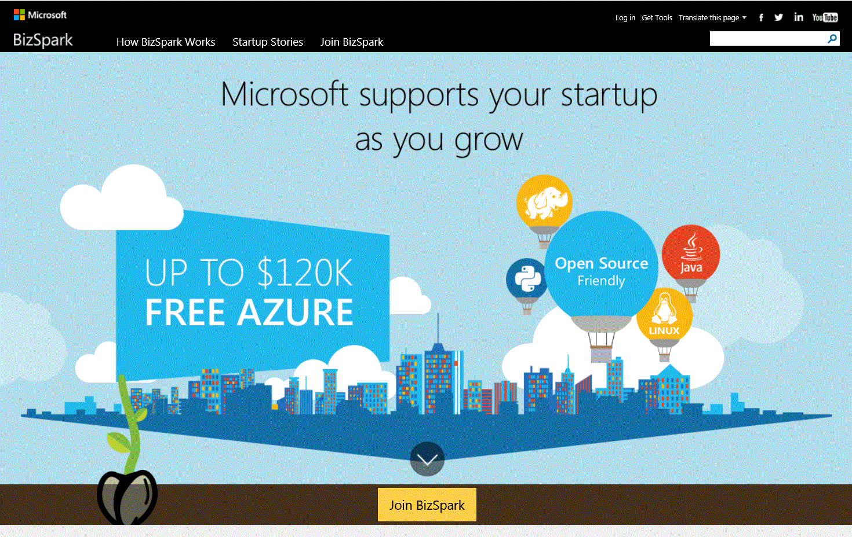
Go to BizSpark.com, click on ‘Join BizSpark.’
This will prompt you to first create a Microsoft Account.
Notes:
Can we put the text on the left into a shaded box to offset it from the website?

Slide 7
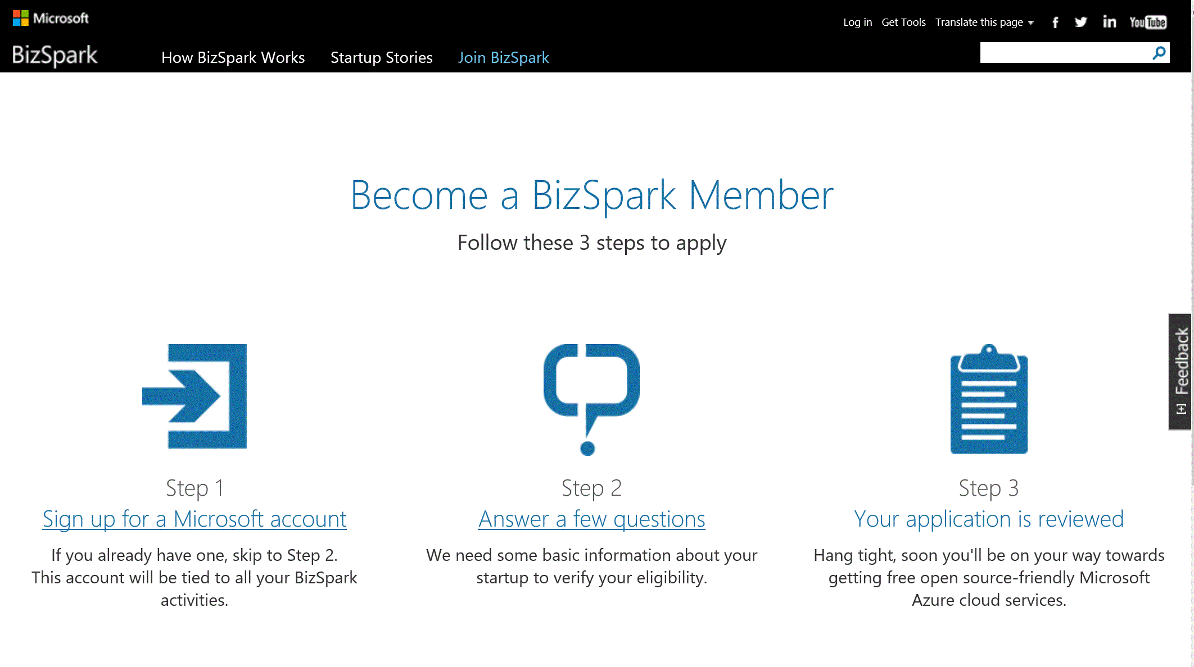
Go through the process to set up a Microsoft account.
Check back here after you have finished the process this and verified your account through email.

Slide 8
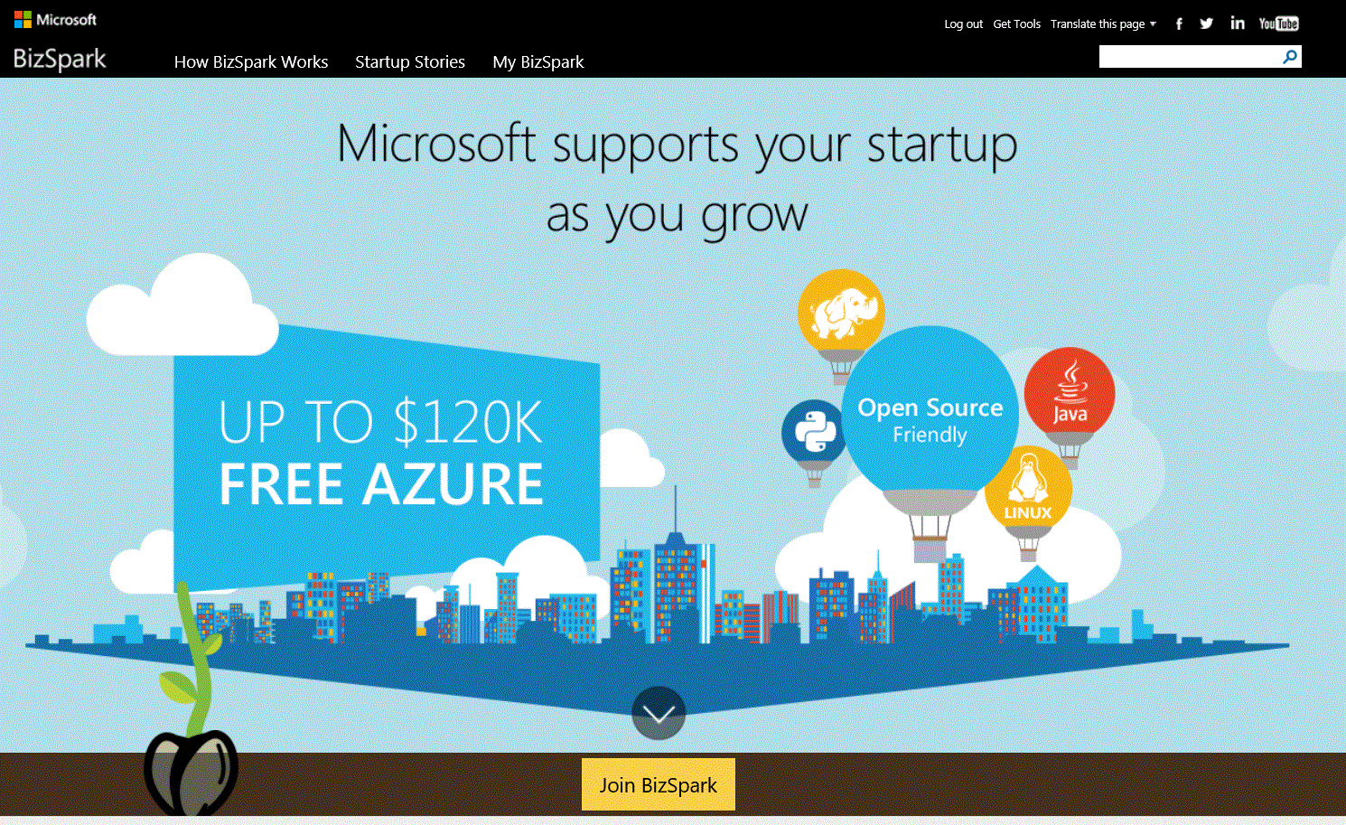
Great! You finished just verified your email.
Scroll up and down this page to see what perks the BizSpark give you.
When you are ready, go to ‘My BizSpark.’
Notes:
Should this be you finished and just verified your email?

Slide 9
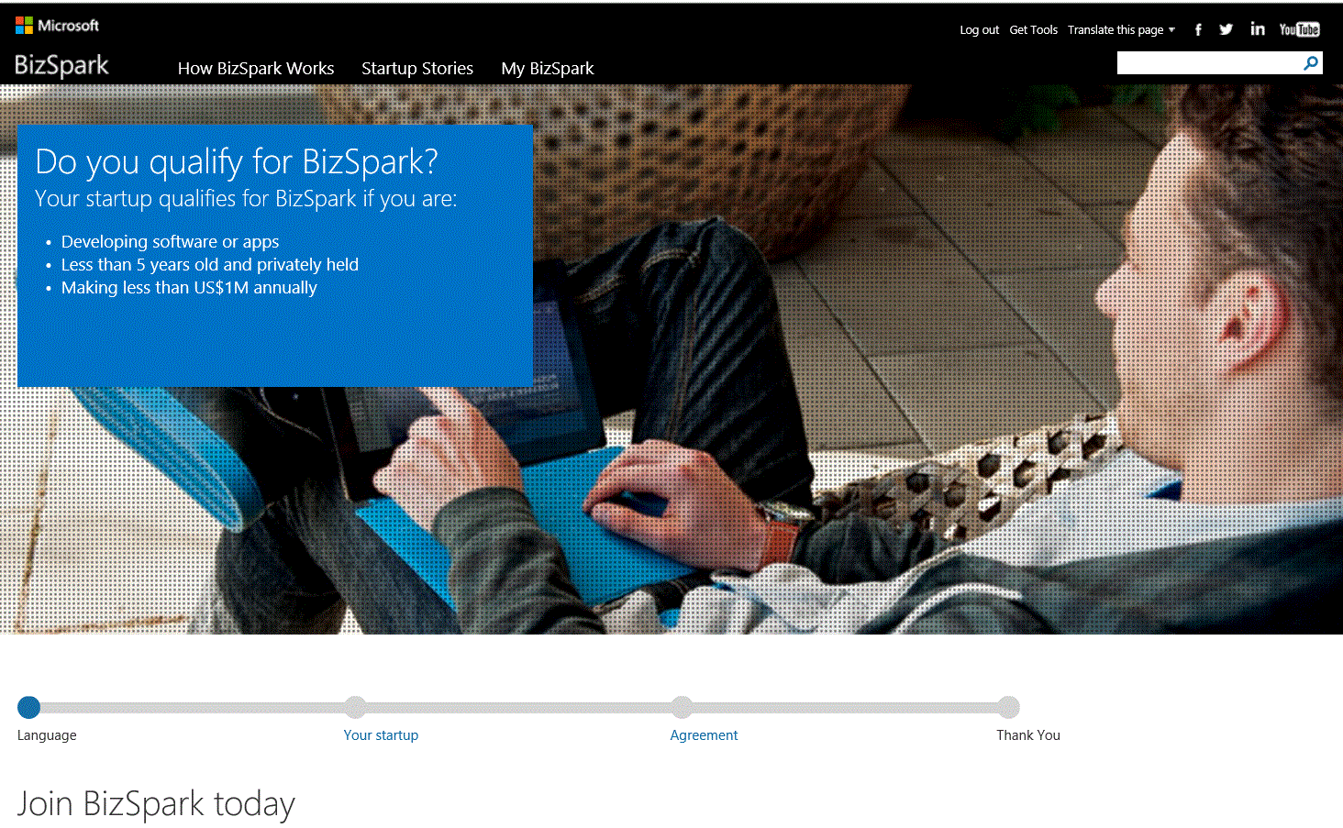
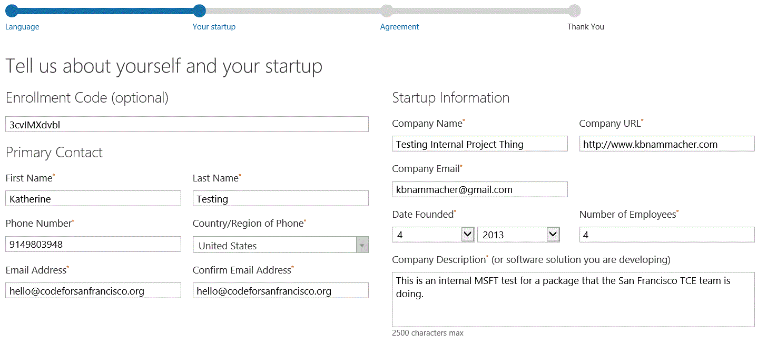
Now you will create a BizSpark account, which is usually for start-ups with a longer approval process. The enrollment codes allow you to get an account quickly.
Make sure you put in your BizSpark enrollment code.
With the start-up information, you can fill this out using your project name and such.
Notes:
"For Startup Information, you can fill this out with details about your hackathon project."

Slide 10
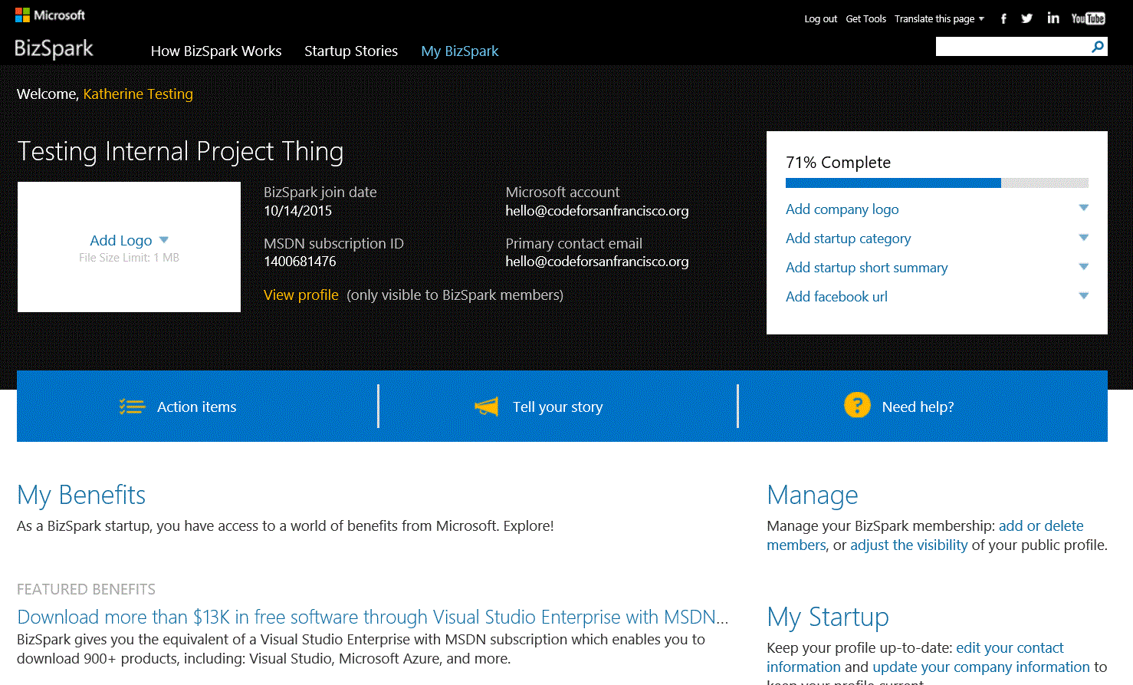
Awesome!
This is your homepage for your BizSpark account. Two notes…
My Benefits:
This is there you get to Azure and all other free Microsoft subscriptions.
Manage:
You can add up to 4 teammates everyone on the project can access the same tools.
Notes:
I believe that your teammates get their own license for the tools, not a shared pool, right? That's a selling point.

Slide 11
Now, let’s get you into Azure (and see the other software you can access.)
Click on ‘My Benefits.’

Slide 12
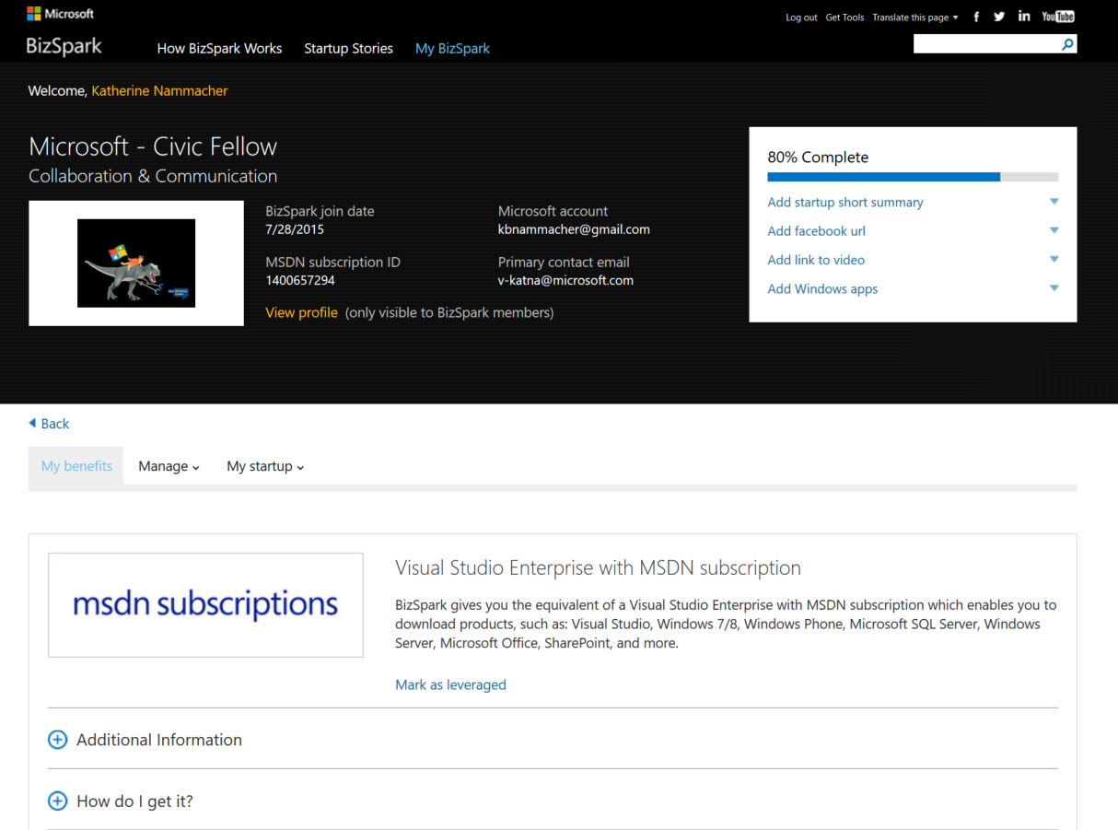
Scroll down the page until you see Azure.

Slide 13
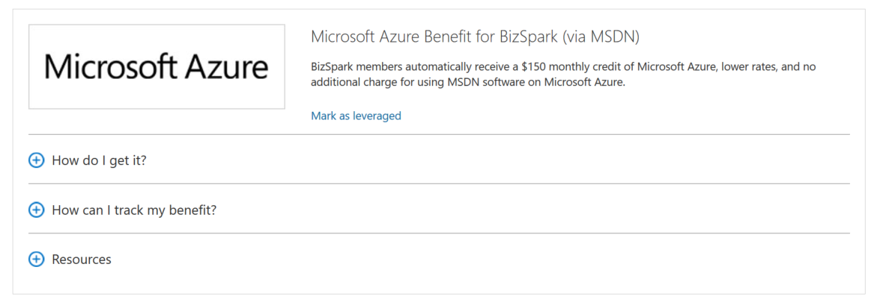
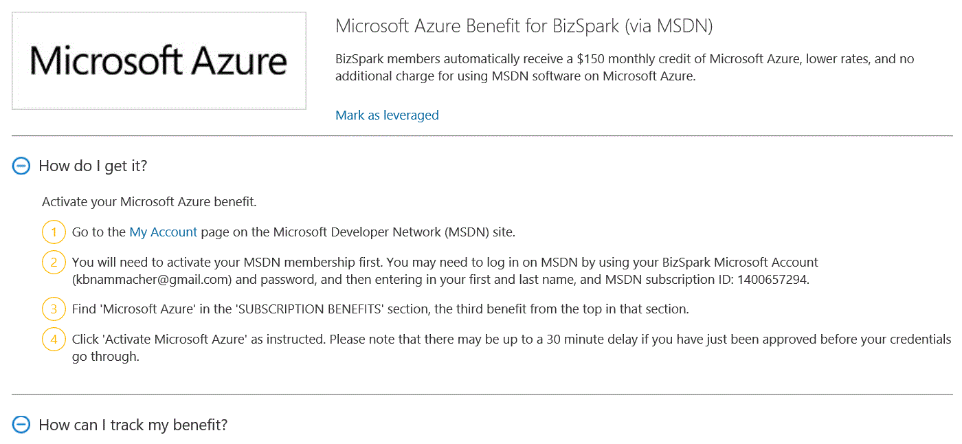
Click ‘How do I get it?’
This tab will expand…
Click “My account.”

Slide 14
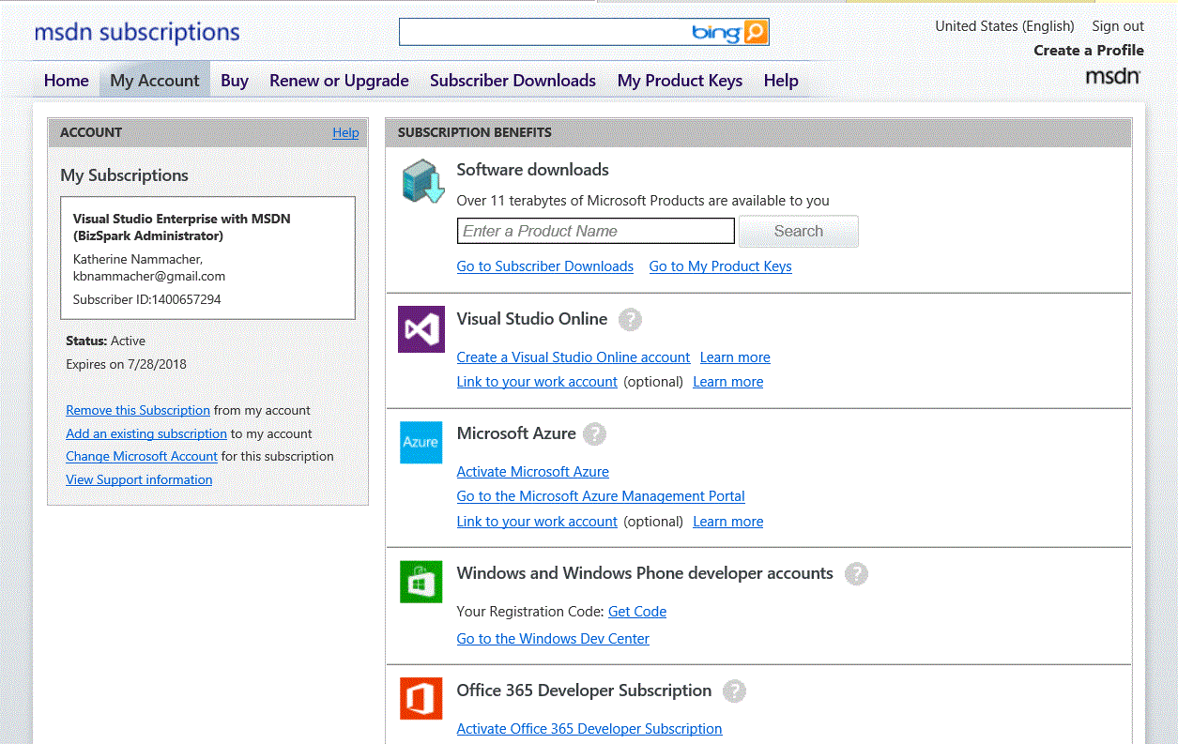
This page has all of your MSDN subscriptions.
Click ‘Activate Microsoft Azure.’
If this pages does not immediately appear, wait a minute and click refresh. Sometimes it takes a couple of minutes for the accounts to sync and get set up.

Slide 15
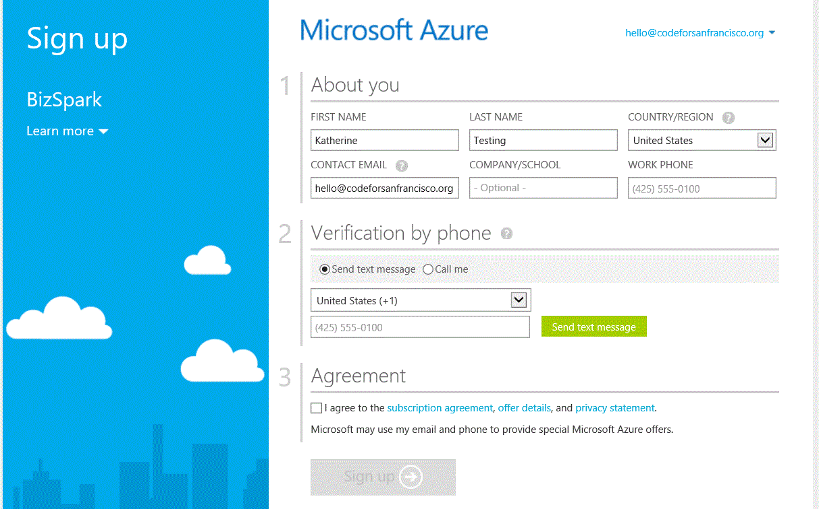
Fill out this last bit of information. Verify by phone or text.
You are so close!
Sometimes there is a lag for this page to load. Just wait a minute as the accounts sync.

Slide 16
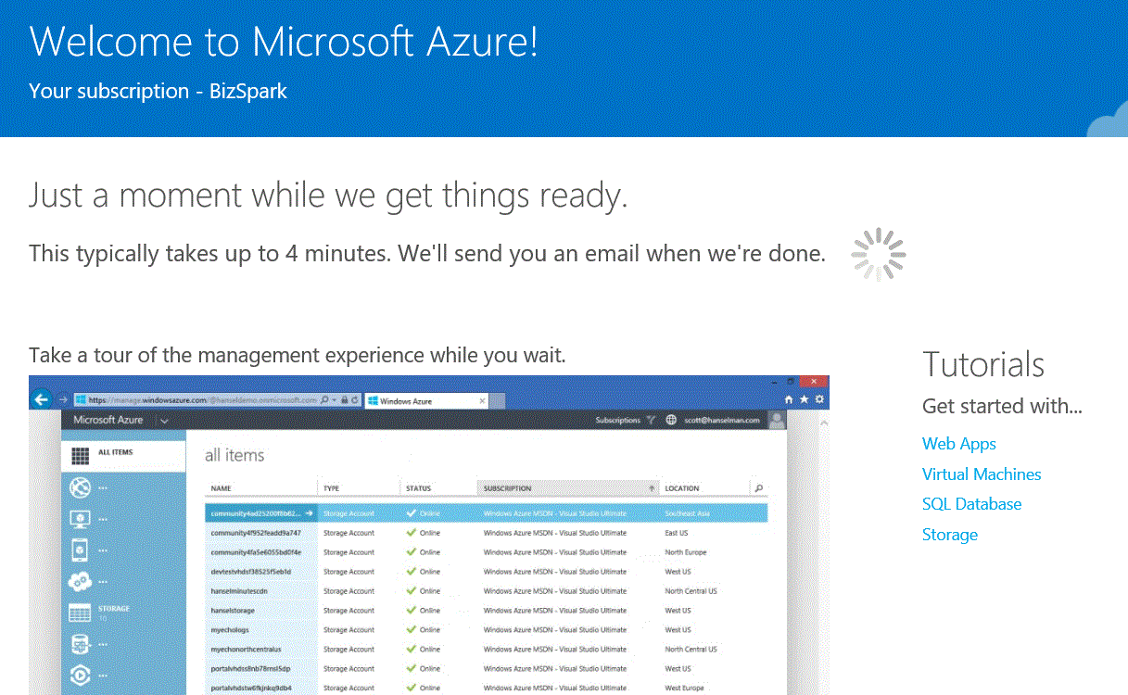
Watch the video while things are setting up.
Sometimes this takes up to 15 minutes.

Slide 17
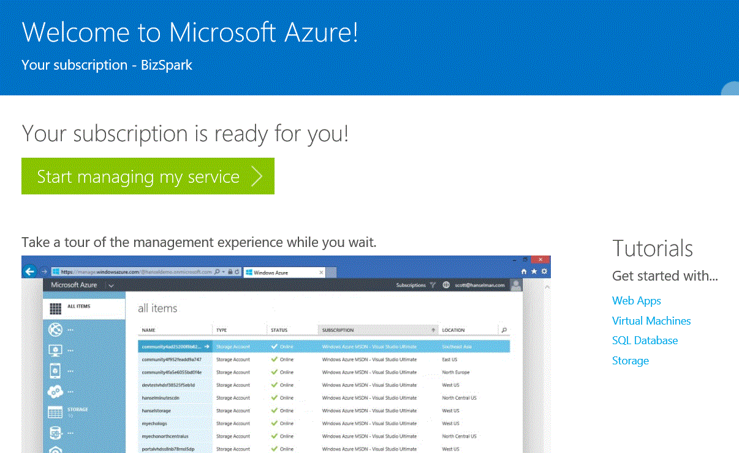
Click ‘start managing my service.’

Slide 18
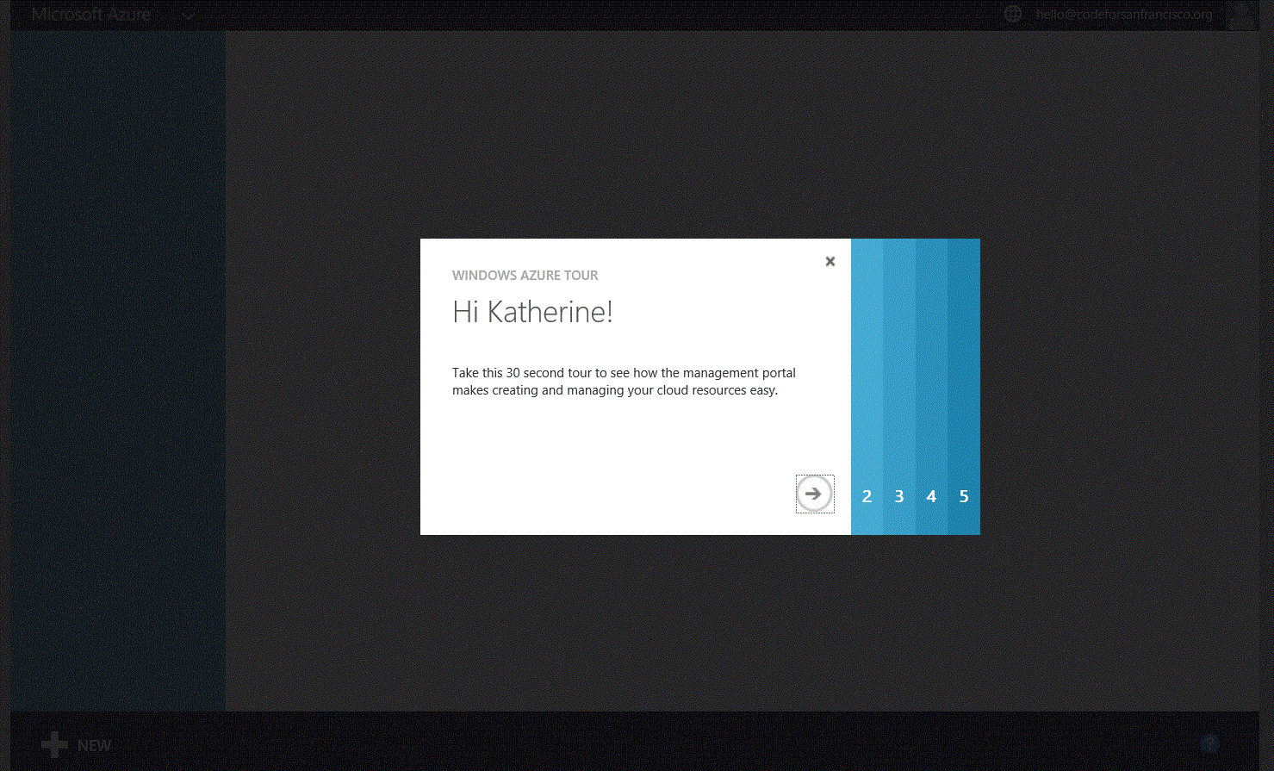
Our quick intro tour.
And you’re in!

Slide 19
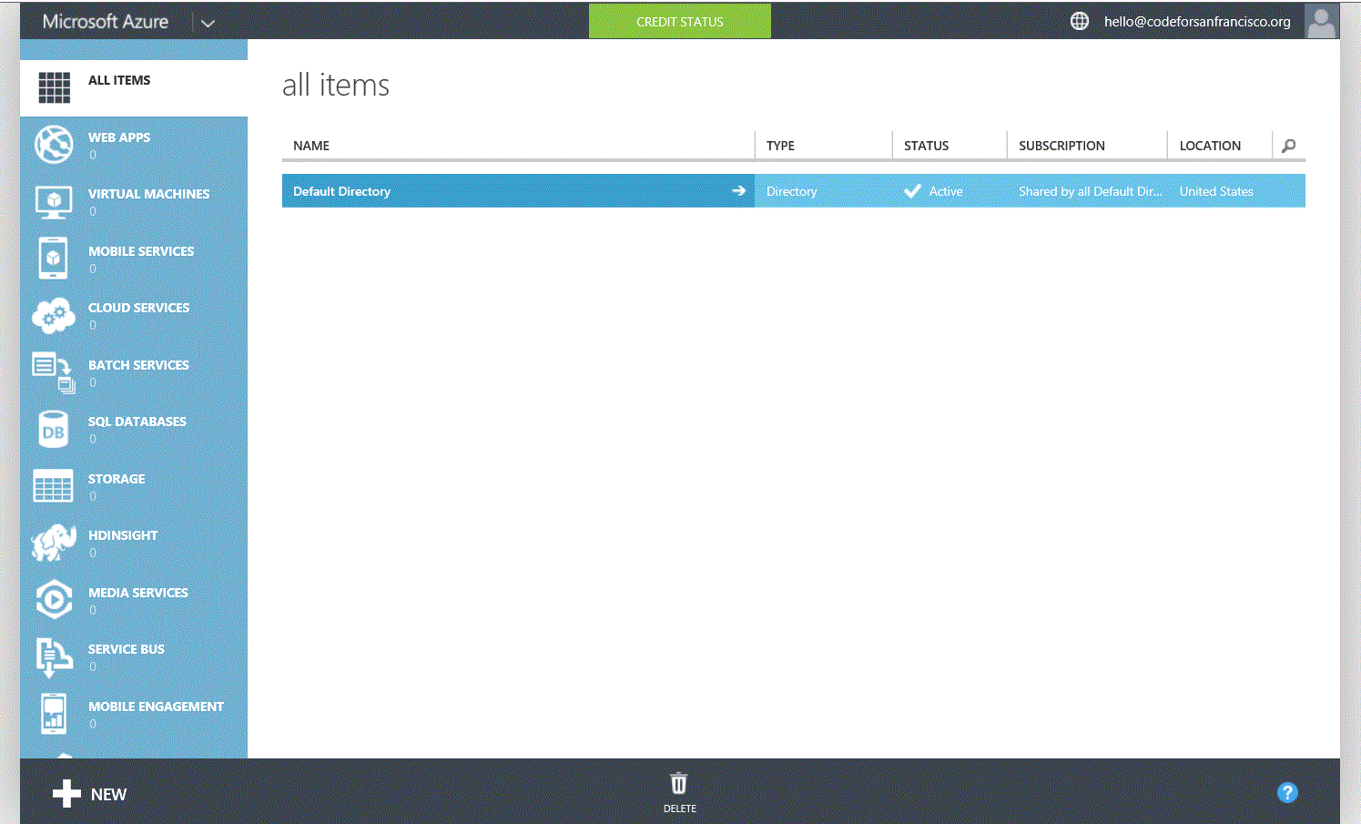
This is the regular home screen.
Create something new with “+ New.”
We also have guides, sample apps, and tutorials to check out.

Slide 20
Congratulations! You have accounts with Microsoft, BizSpark, and Azure. Happy hacking!

